Slide 1
Orange
Pasquale Cascarano
Assistant Professor
Department of the Arts

Slide 2
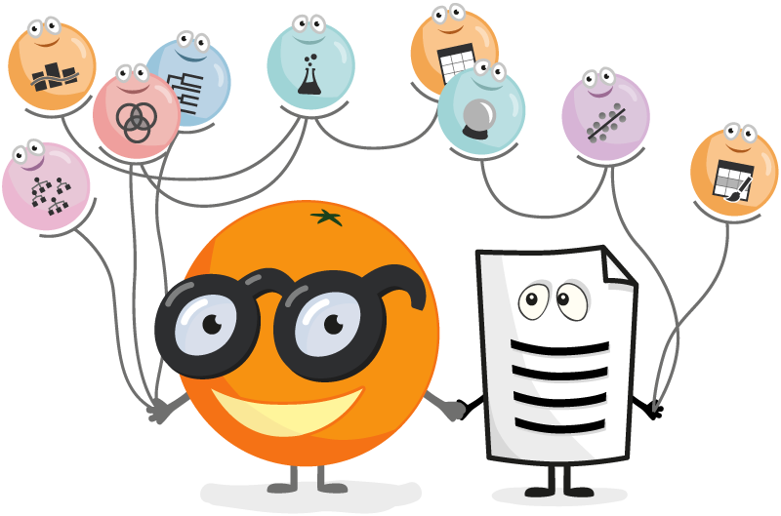

What is Orange?
Dataset per problemi di classificazione nel fashion​
Orange is a free software created to perform Data Mining (extract info by data), Machine learning and data visualization without code!
It allows you to create data analysis workflows visually, with tons of useful tools.
Orange is the perfect software for Machine Learning and statistical operations without code!
We will see the power of Orange applied to different domains in fashion such as text, images and time series!
Download: https://orangedatamining.com/download/

Slide 3
Why Orange?
Teachers and students love it;
Interactive data visualization;
Visual programming;
It provides a lot of features in addition to the basic ones;
Dataset per problemi di classificazione nel fashion​

Slide 4
Teachers and students love it
Orange is the perfect tool for practical training;
Teachers appreciate the clear program design and visual explorations of data and models;
Students benefit from the tool's flexibility and the ability to invent new combinations of data mining methods;
Orange's educational strength comes from the combination of visual programming and interactive visualizations. We have also designed some educational widgets that have been explicitly created to support teaching.
Here are some sample workflows we recently used in data mining training (yes, we not only develop Orange, we also teach with it).
Dataset per problemi di classificazione nel fashion​

Slide 5
Interactive data visualization
Orange is focused on data visualizations that help uncover patterns of data patterns, provide insights behind data analysis procedures, or support communication between data scientists and domain experts;
View widgets include a variety of viewing tools: scatter plot, box plot and histogram, and specific views of some ML models;
Why interactive? Points can be selected from a scatter plot, a node in a decision tree and many other interactions;
Any of these interactions will cause a specific change in the various widgets.
Dataset per problemi di classificazione nel fashion​

Slide 6
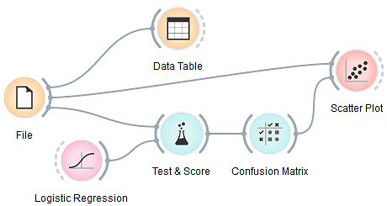
Visual programming
Orange is a great data mining tool for both beginners and experienced data scientists;
Thanks to the simple user interface, users can focus on data analysis rather than laborious coding, making it easy to build complex data analysis pipelines;
Dataset per problemi di classificazione nel fashion​

Slide 7
Visual programming – Components
With Orange, data analysis is performed by stacking components in workflows;
Each component also called a widget, incorporates some data collection and processing, visualization, modeling, or evaluation activities;
Each widget possesses:
  a color, which indicates its class;
  A bonding structure (pre/post linking);
  Your own responsibility;
Combining different widgets in a workflow allows you to create data analysis patterns piece by piece;
Dataset per problemi di classificazione nel fashion​

Slide 8
Visual programming – Components and Workflow
The orange widgets communicate with each other;
Through linking, they receive input data and send data, templates or whatever the widget produces;
For example, we could start with a File widget that reads the data and links its output to another widget, such as a machine learning model that learns from that data, finally followed by an evaluation widget for that algorithm!
After any modification in a widget, the changes are instantly propagated through the workflow to all other connected widgets;
E.g., editing a data file in the File widget will trigger the response in all other widgets.
There is therefore a form of workflow reuse!
Dataset per problemi di classificazione nel fashion​

Slide 9
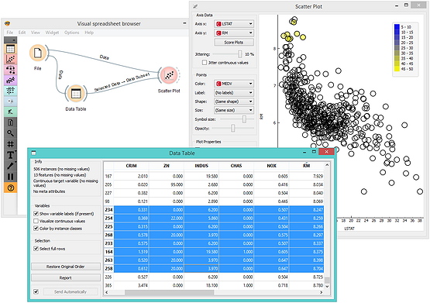
Visual programming – Components and interactive visualization
This is especially fun when widgets are open and when you can immediately see the results of any changes to that data, method parameters or selections in interactive views;
For example, in a simple workflow below, where the data selection in the spreadsheet propagates to a scatter chart, which marks the selected data instances.
Dataset per problemi di classificazione nel fashion​

Slide 10
Many add-ons
Use the various add-ons available in Orange to extract data from external data sources, perform natural language processing and text extraction, analyze time series etc…
In addition, among others, there is an add-on that allows you to analyze images and build on them Machine learning algorithms! We will field this add-on with a very special dataset.
Dataset per problemi di classificazione nel fashion​

Slide 11
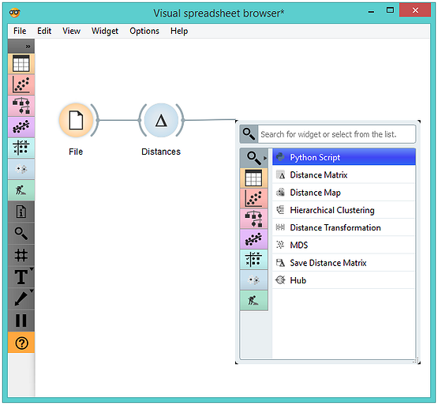
Why Orange? (extra)
Orange is fully coded in Python!
What does this mean? You can write python code to completely customize your Orange experience or you can build new widgets to help the community!
Dataset per problemi di classificazione nel fashion​

Slide 12
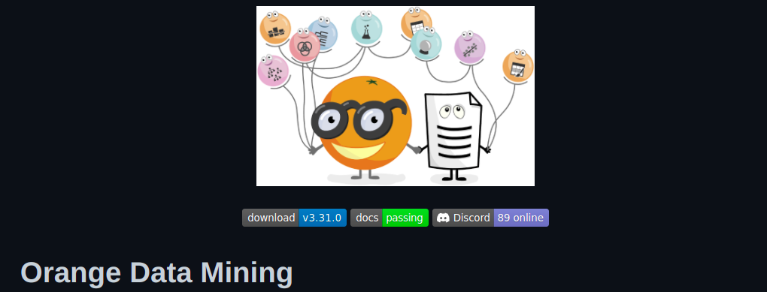
Why Orange? (extra)
Dataset per problemi di classificazione nel fashion​
Orange is entirely opensource!
All the code is free and editable to your liking and is located directly on GitHub!
There is a community that continues to develop free add-ons to increase the number of tools that people who can't code can use!
See this page: https://github.com/orgs/biolab/repositories

Slide 13
Let's get along with Orange using Iris
Pasquale Cascarano
Assistant Professor
Department of the Arts

Slide 14
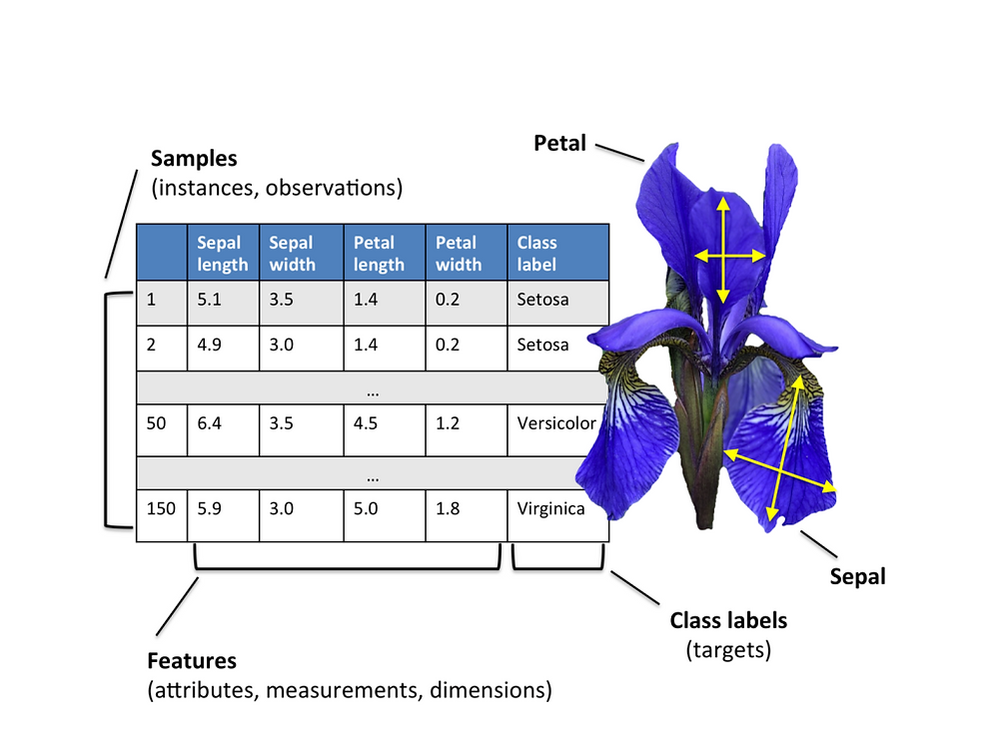
Iris dataset
This is perhaps the best-known database found in the pattern recognition literature;
The dataset contains 3 classes of 50 instances each, where each class refers to a type of iris plant;
It contains a small challenge from a mathematical point of view;
Expected attribute: class of the iris plant;
Characteristics:
  length of the sepal in cm
  sepal width in cm
  petal length in cm
  petal width in cm
  classes: Iris Setosa, Iris Versicolor, Iris Virginica

Slide 15
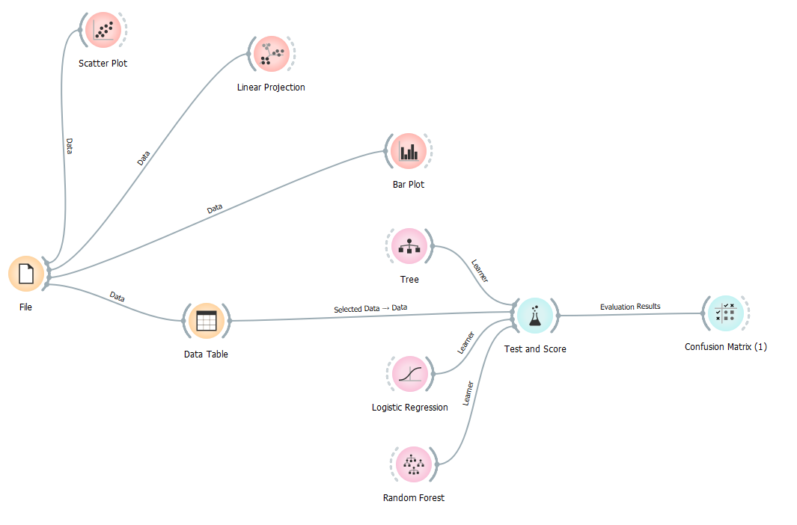
General workflow
V
I
S
U
A
L
I
Z
A
T
I
O
N
C
L
A
S
S
I
F
I
C
A
T
I
O
N

Slide 16
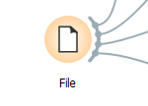
We upload the dataset directly from Orange!
Orange provides ready-made datasets to get familiar with the software;
We will start with the now famous iris dataset;
To load it just use the widget file, click it and choose iris.tab!

Slide 17
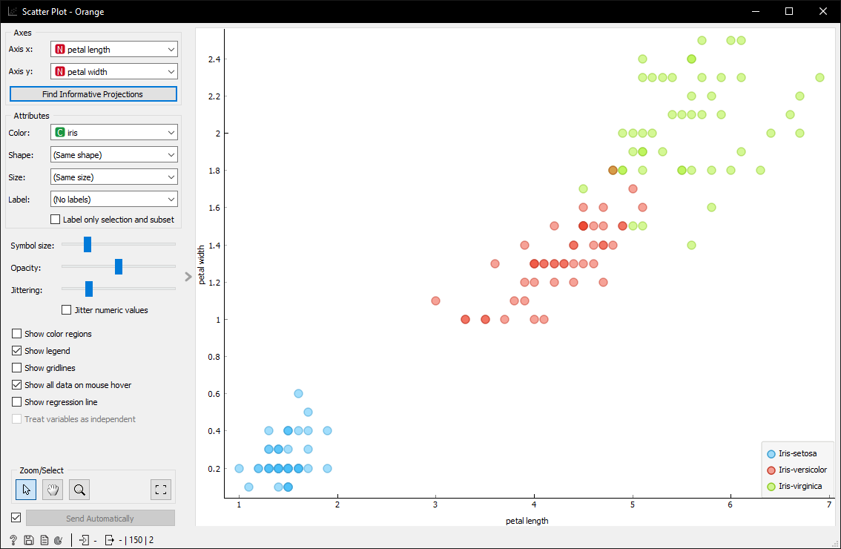

Data visualization: scatter plot

Slide 18
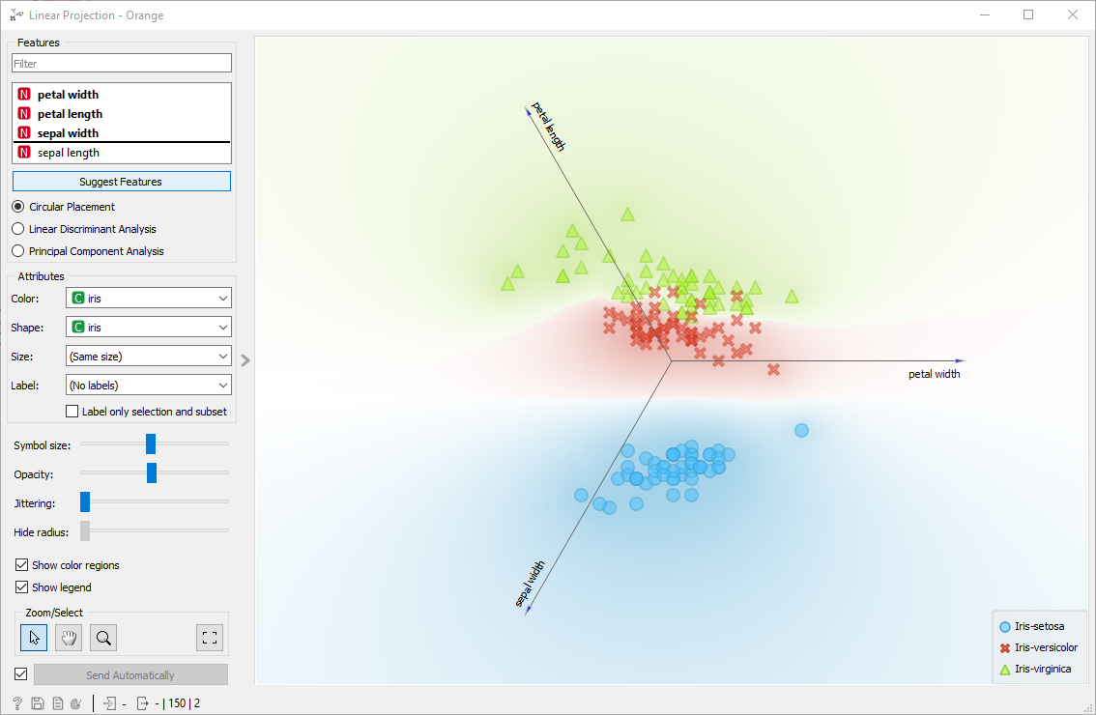
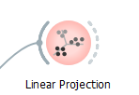
Data display: Linear projection

Slide 19
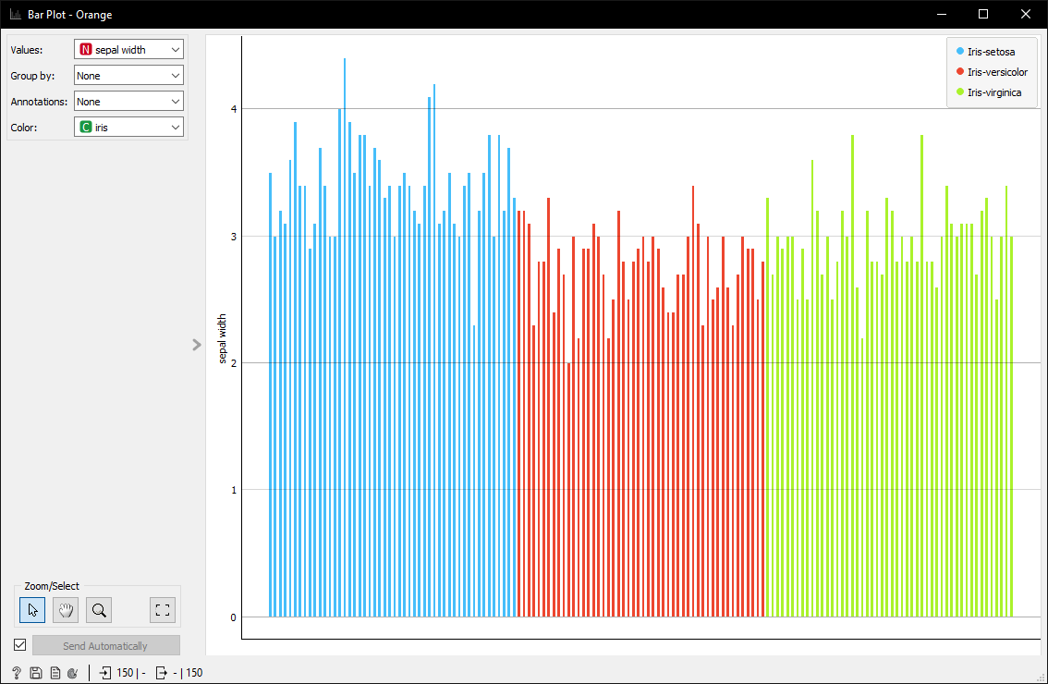
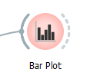
Data visualization: Bar plot

Slide 20
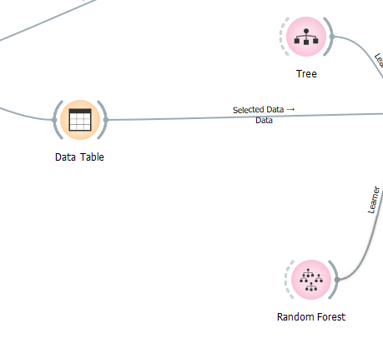
Let's create a tree and a random forest
To create two classifiers, just drag and drop the “Tree” and “Random forest” widgets into the scene!
In the meantime, let's add a “data table” widget and link it to the “file” widget, this will allow orange to treat the file as tabular data!

Slide 21
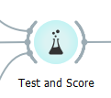
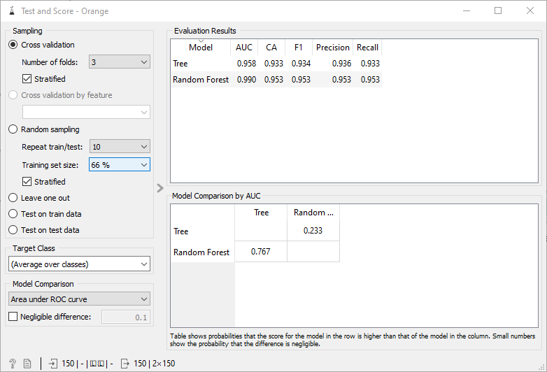
Evaluate two model together?
Yes: if you connect two different models to the same evaluation module, they will be compared immediately!
This makes it easy to choose the best model possible (and you can do it with two simple clicks)!

Slide 22
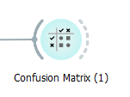
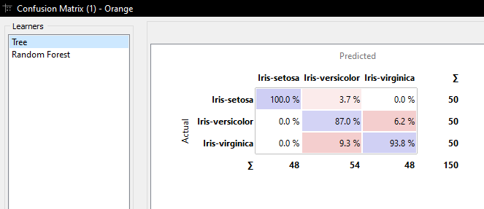
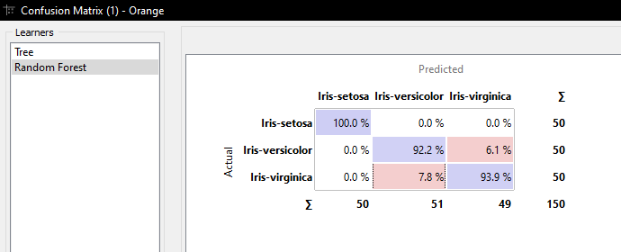
Evaluate two model together?
Finally, we can print the confusion matrix on the evaluation, to get a complete picture of the performance of our models!

Slide 23
IMAGO analysis con Orange
Pasquale Cascarano
Assistant Professor
Department of the Arts

Slide 24
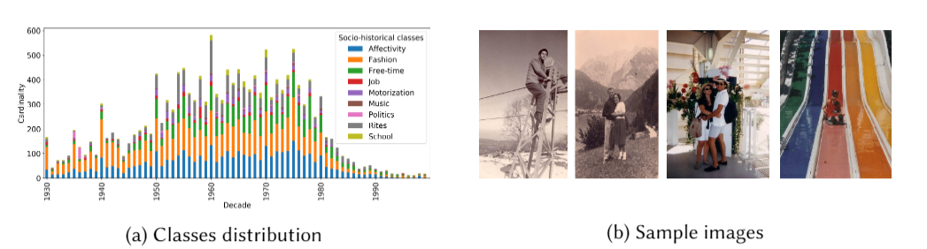
The IMAGO project
Dataset per problemi di classificazione nel fashion​
The IMAGO project was started in 2004 by social historians to study the evolution of Social History through the lenses of photographs from family albums;
This collection today consists of both analogue and digital photos and is collected year by year and kept by the Department of Arts of the University of Bologna in collaboration with Professor Daniela Calanca;
The collection includes about 80,000 photos, taken between 1845 and 2009, belonging to about 1,500 Italian families;

Slide 25
An important dataset, also from a Machine Learning point of view
We have published several works with the theme imago, which mainly concern the Machine Learning community;
Lorenzo Stacchio, Alessia Angeli, Giuseppe Lisanti, Daniela Calanca, and Gustavo Marfia. 2021. Towards a holistic approach to the socio-historical analysis of vernacular photos. ACM Trans. Multimedia Comput. Commun. Appl (December 2021);
L. Stacchio, A. Angeli, S. Hajahmadi, G. Marfia: Revive Family Photo Albums through a Collaborative Environment Exploiting the HoloLens 2. In Proceedings of the 2021 IEEE International Symposium on Mixed and Augmented Reality Adjunct (ISMAR-Adjunct);
L. Stacchio, S. Hajahmadi and G. Marfia, "Preserving Family Album Photos with the HoloLens 2," 2021 IEEE Conference on Virtual Reality and 3D User Interfaces Abstracts and Workshops (VRW), 2021, pp. 643-644, doi: 10.1109/VRW52623.2021.00204.;
Dataset per problemi di classificazione nel fashion​

Slide 26
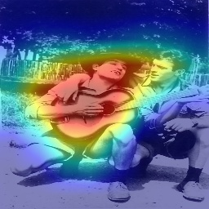
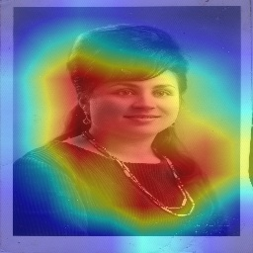
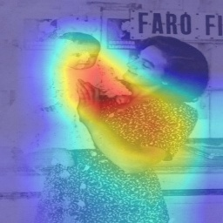
Towards a holistic approach to the socio-historical analysis of vernacular photos
Develop deep learning models to catalog family album photos based on the shooting date and historical-social context;
The results of our work showed that deep learning (CNN) models are able to focus on interesting historical-social characteristics when classifying a photo;

Slide 27
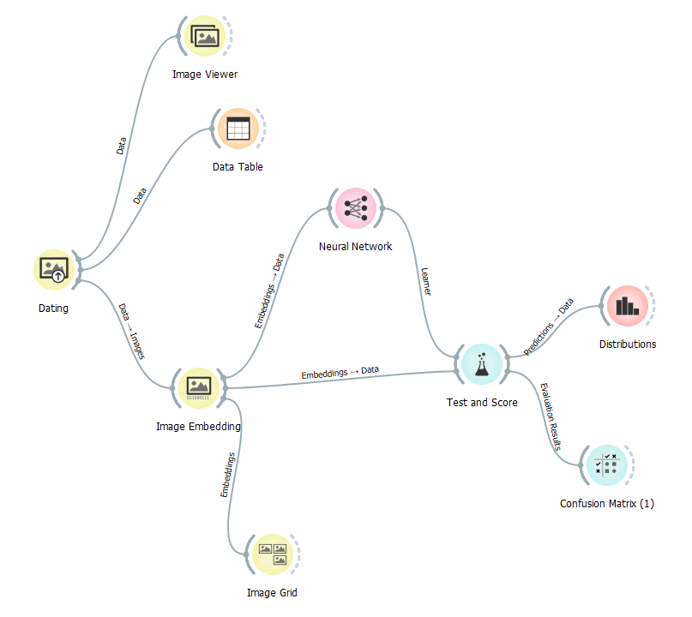
Let's analyze IMAGO with Orange!
This is the workflow we will create to classify and analyze the IMAGO dataset;
But first, you will have to download a small subset that I have prepared for you, so that your PCs are also able to do the analyzes!
The subset of the IMAGO dataset can be downloaded from the Virtuale;

Slide 28
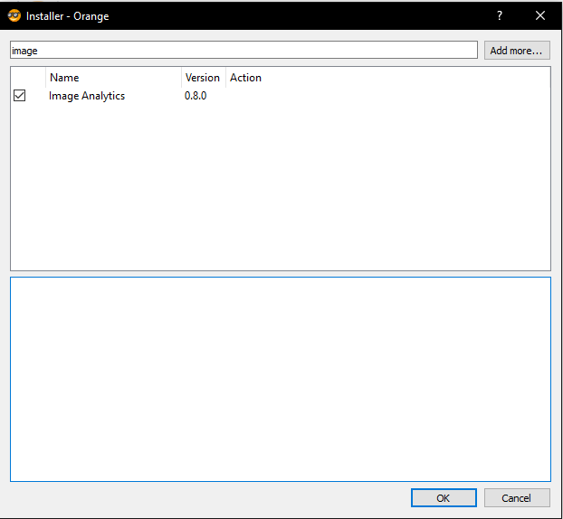
Preliminary step
Install the add-on for images from:
  Options;
  Add-ons;
  Cercate Image Analytics;
  Selezionatela;
  Click ok;

Slide 29
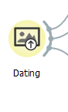
Let's start with dating: importing a folder of images
Create an “Import Image” widget;
Click on it and select the "dating" folder, the location depends on your PC (if you have just downloaded it, it is in the Download folder);

Slide 30
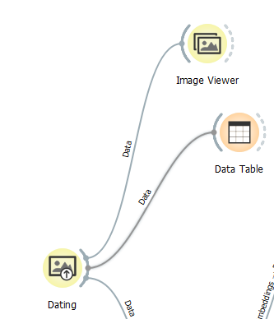
Let's start with dating let's explore the data
We can create two different widgets, to explore the images from two different points of view:
  Image viewer will allow you to explore images by viewing them;
Data Table will convert your images into table records so that you can explore them textually!

Slide 31
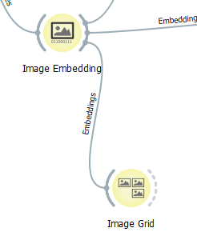
Let's start with dating: image embeddings
Let's create an “Image Embedding” widget;
This widget takes advantage of pre-trained CNNs to create good image representations (remember?)!
With that done, create an “Image Grid” widget and enjoy exploring the magic of deep learning!

Slide 32
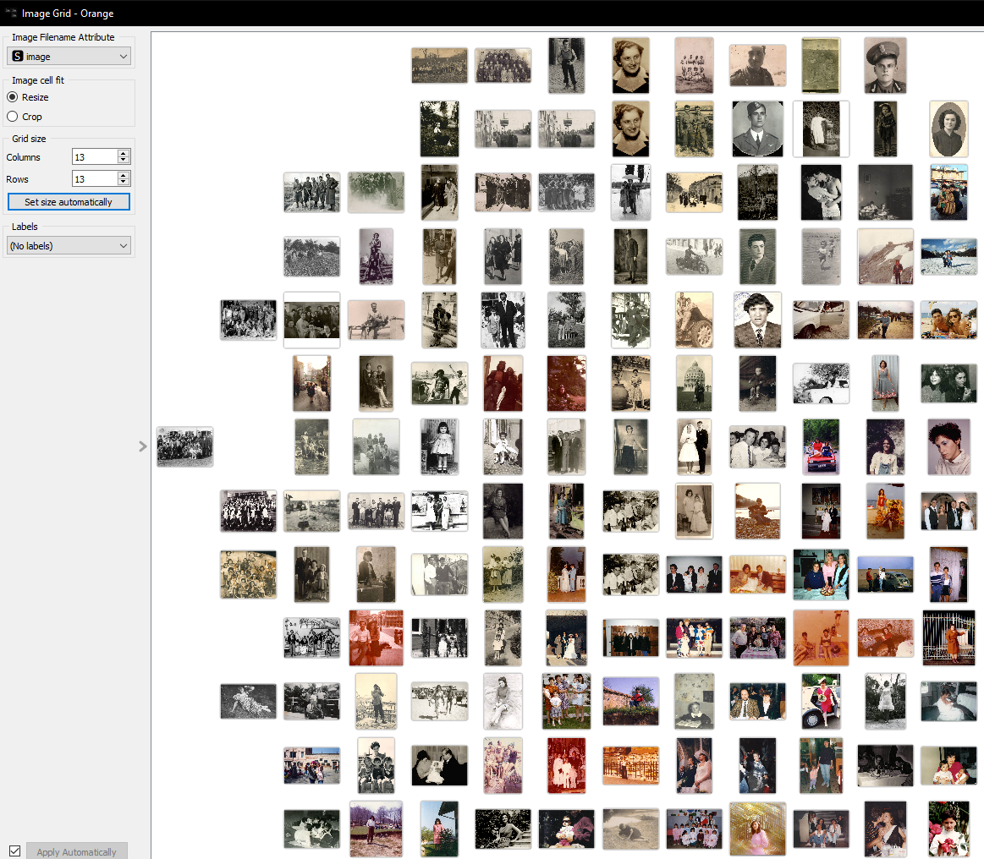
The Image grid widget exploits Deep learning extrapolated features to group similar images!

Slide 33
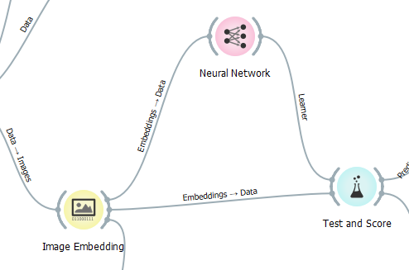
Let's start with dating: train a neural network to classify our images by decade!
Let's create a “Neural Network” widget;
This Widget will create a real and simple Multi-feed forward neural network that will learn from Image Embeddings!
You can then evaluate its performance with test and score widget!

Slide 34
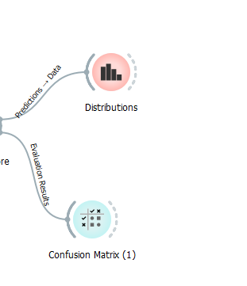
Let’s check the results also with the distribution widget
The distribution widget allows to visualize the distribution of a certain variable of your data;
It could be used after a Test and score widget, to visualize the distributions of the models predictions!

Slide 35
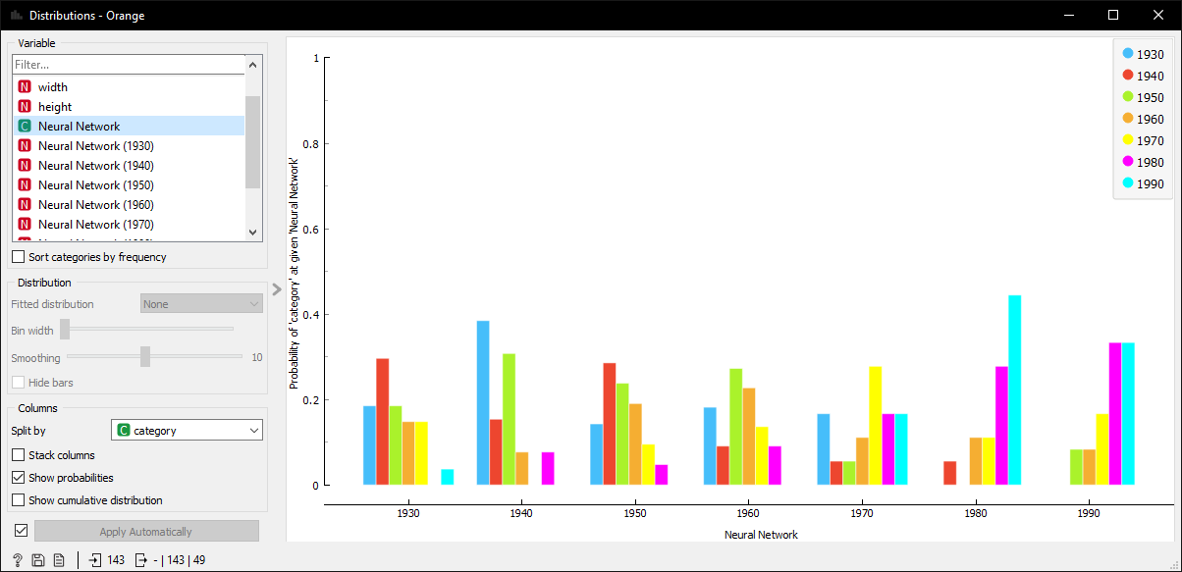
The distribution widget

Slide 36
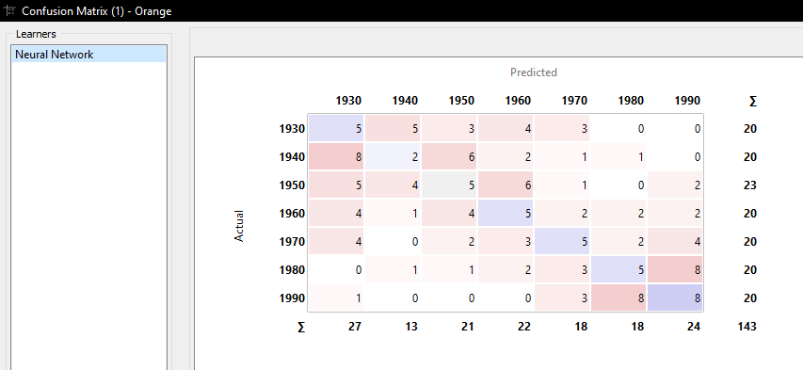
Confusion matrix

Slide 37
We can use the same workflow for the socio-historical dataset!
Reusing Orange widget schema is a powerful thing;
By clicking on the “Import Images” widget and changing the folder, selecting the “socio-historical context” and you already have done all you need to analyze the socio-historical dataset, with the same schema of the dating one!
Although the task has changed, we had everything ready, and we didn't have to do anything!

Slide 38
How long would it take us to code all this in python?
At least two hours of coding;
  Upload the dataset;
  Instantiate a pre-trained Deep Learning model;
  Create a function to generate the embeddings from it;
  Define a neural network model;
  Train it;
  Create cross-validation metrics;
  Create a confusion Matrix;
  Calculate the metrics;
  Calculate a histogram of the classifications ...
Thanks to this visual approach, not only did we do everything quickly, but you will remember all the workflow, the widgets, and how to compose them!
The visual approach is essential in learning!

Slide 39
Orange per il fashion: Fashion MNIST
Pasquale Cascarano
Assistant Professor
Department of the Arts

Slide 40
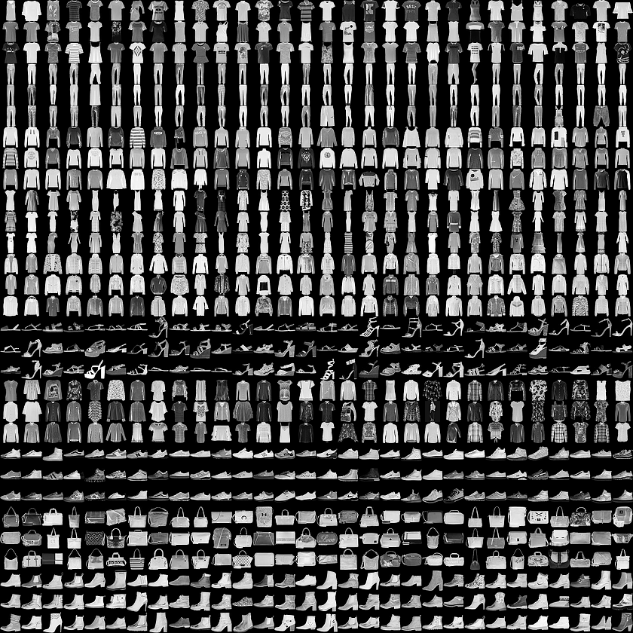
Fashion MNIST
Fashion-MNIST is a dataset of Zalando’s article images consisting of a training set of 60,000 samples and a test set of 10,000 samples.
Each example is a 28×28 grayscale image, associated with a label from 10 different classes.

Slide 41
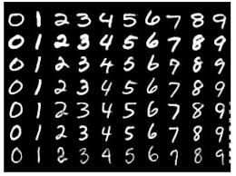
Why is this topic of interest for the scientific community?
The original MNIST dataset contains images of handwritten digits. Researchers from Data Science community use this dataset as a benchmark to validate their learning algorithms. In fact, MNIST is often the first dataset they would try on. “If it doesn’t work on MNIST, it won’t work at all”, they said. “Well, if it does work on MNIST, it may still fail on others.”
Fashion MNIST is intended to serve as a direct drop-in replacement for the original MNIST dataset to benchmark machine and deep learning algorithms, as it shares the same image size and the structure of training and testing splits.
Researchers are talking about replacing MNIST. The following are some good reasons:
MNIST is too easy;
MNIST is overused ;
MNIST can not represent modern CV tasks ;

Slide 42
0: T-shirt/Top
1: Trouser
2: Pullover
3: Dress
4: Coat
5: Sandal
6: Shirt
7: Sneaker
8: Bag
9: Ankle Boot
The 10 different classes
of Fashion MNIST dataset

Slide 43
0: T-shirt/Top
1: Trouser

Slide 44
2: Pullover
3: Dress

Slide 45
4: Coat
5: Sandal

Slide 46
6: Shirt
7: Sneaker

Slide 47
8: Bag
9: Ankle Boot

Slide 48
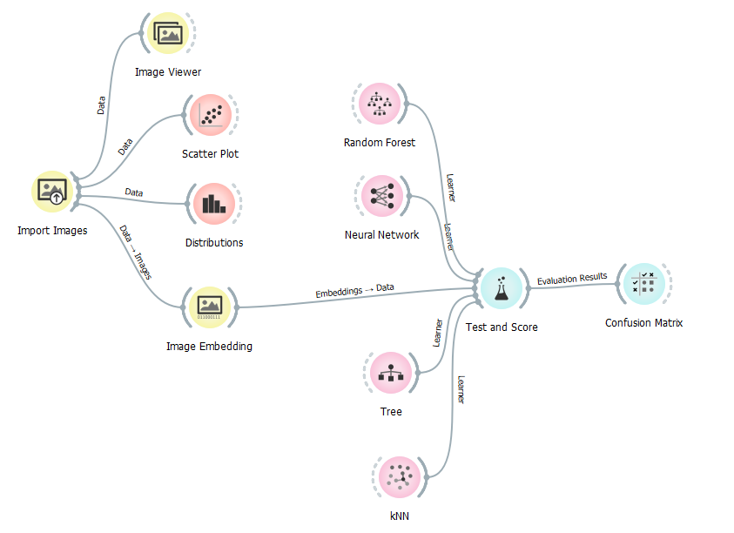
Let's analyze FashionMINST with Orange!
This is the workflow we will create to classify and analyze the FashionMNIST dataset;
But first, you will have to download a small subset that I have prepared for you, so that your PCs are also able to do the analyzes!
The subset of the FashionMNIST dataset can be downloaded from Virtuale;

Slide 49
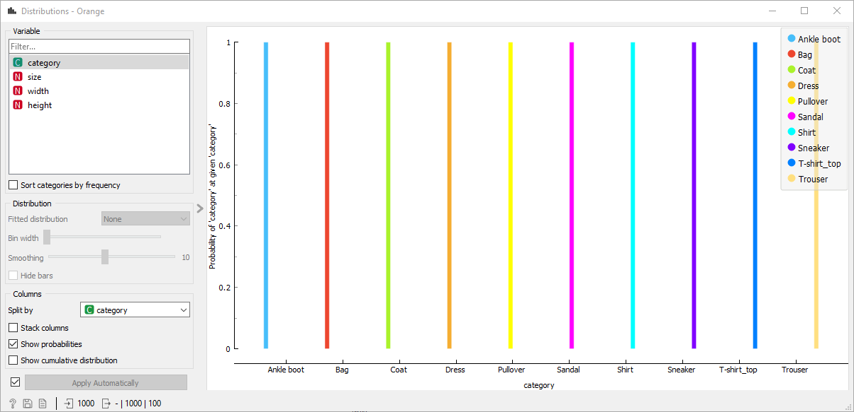
Distribution widget
The distribution widget allows to visualize the distribution of a certain variable of your data;
We are here considering labelled images, so we can visualize the distribution of the fashion item categories, and the size (memory occupied in bytes), width, height of the images.
Those values would be all splitted by the target variable: i.e., the category!

Slide 50
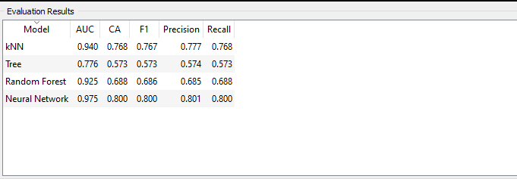
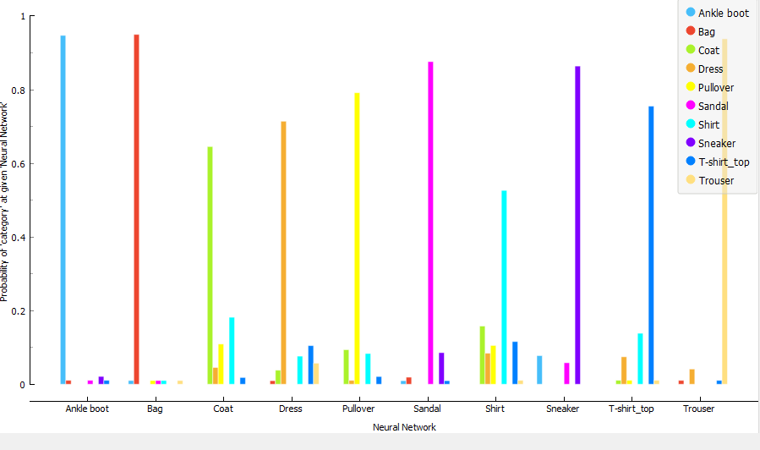
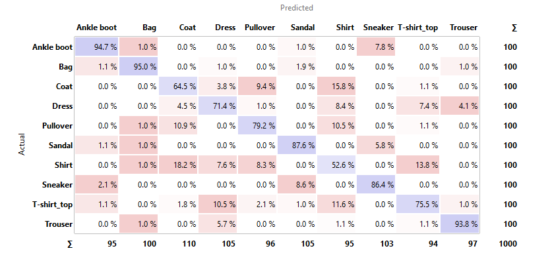
What kind of results we have obtained on FashionMNIST?

Slide 51
Hierarchical clustering
Pasquale Cascarano
Assistant Professor
Department of the Arts

Slide 52
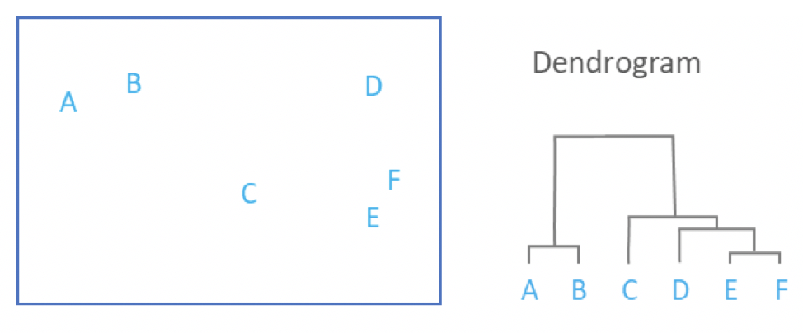
Unsupervised Machine learning and Hierarchical clustering
Hierarchical clustering is a machine-learning-based algorithm that groups similar objects into groups called clusters.
The endpoint is a set of clusters, where each cluster is distinct from each other cluster, and the objects within each cluster are broadly similar to each other.
How similar objects are, can be decided with image features coming from Deep Learning models in Orange and a distance metric!

Slide 53
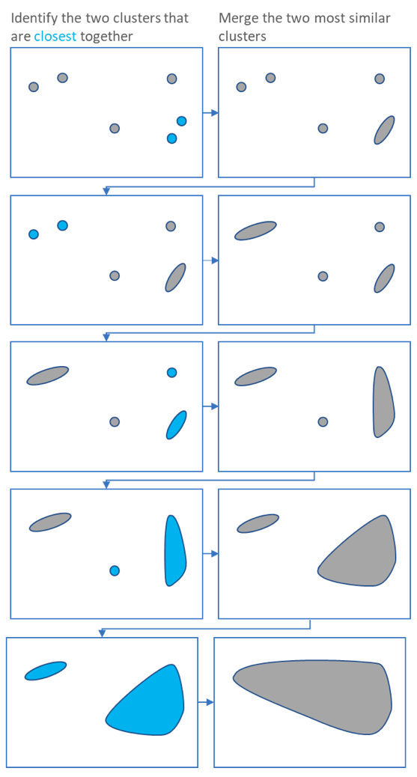
How Hierarchical clustering works
Hierarchical clustering starts by treating each observation as a separate cluster.
Then, it repeatedly executes the following two steps: (1) identify the two clusters that are closest together, and (2) merge the two most similar clusters.
This iterative process continues until all the clusters are merged together;

Slide 54
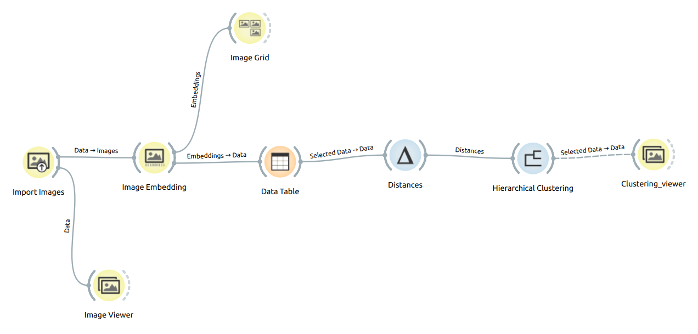
Clustering with Orange

Slide 55
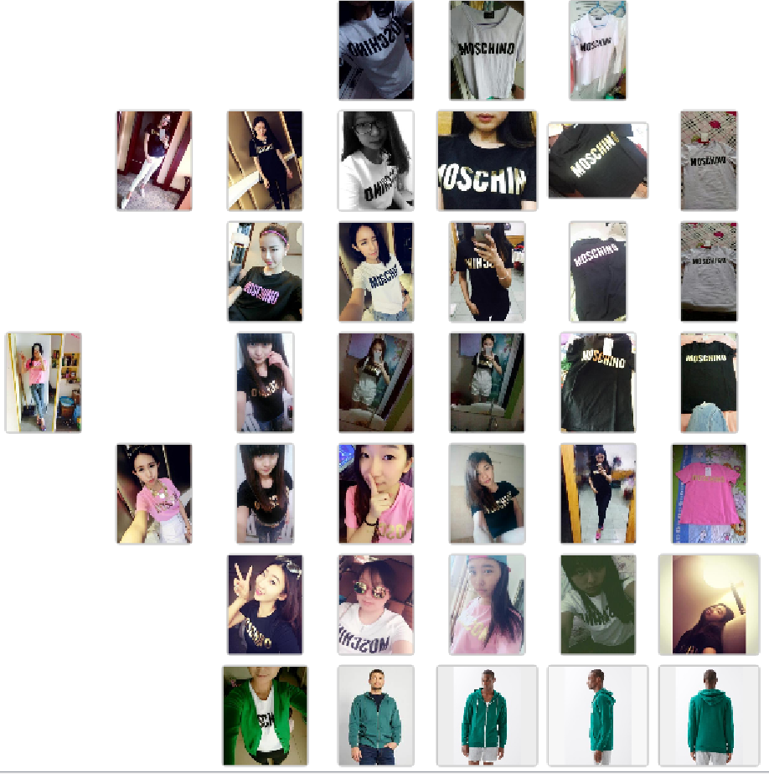

Slide 56
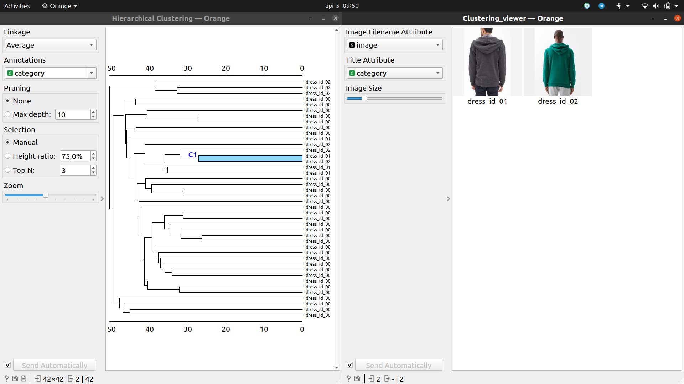
Finding the most interesting clusters!

Slide 57
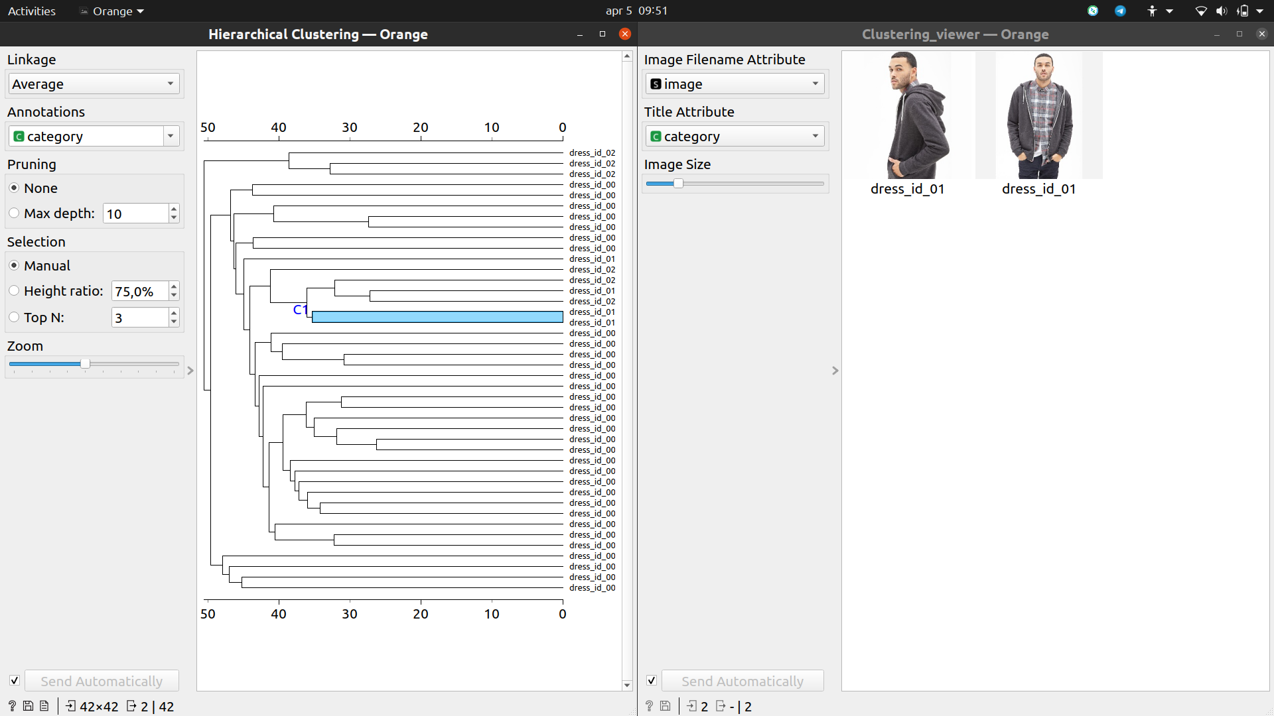

Slide 58
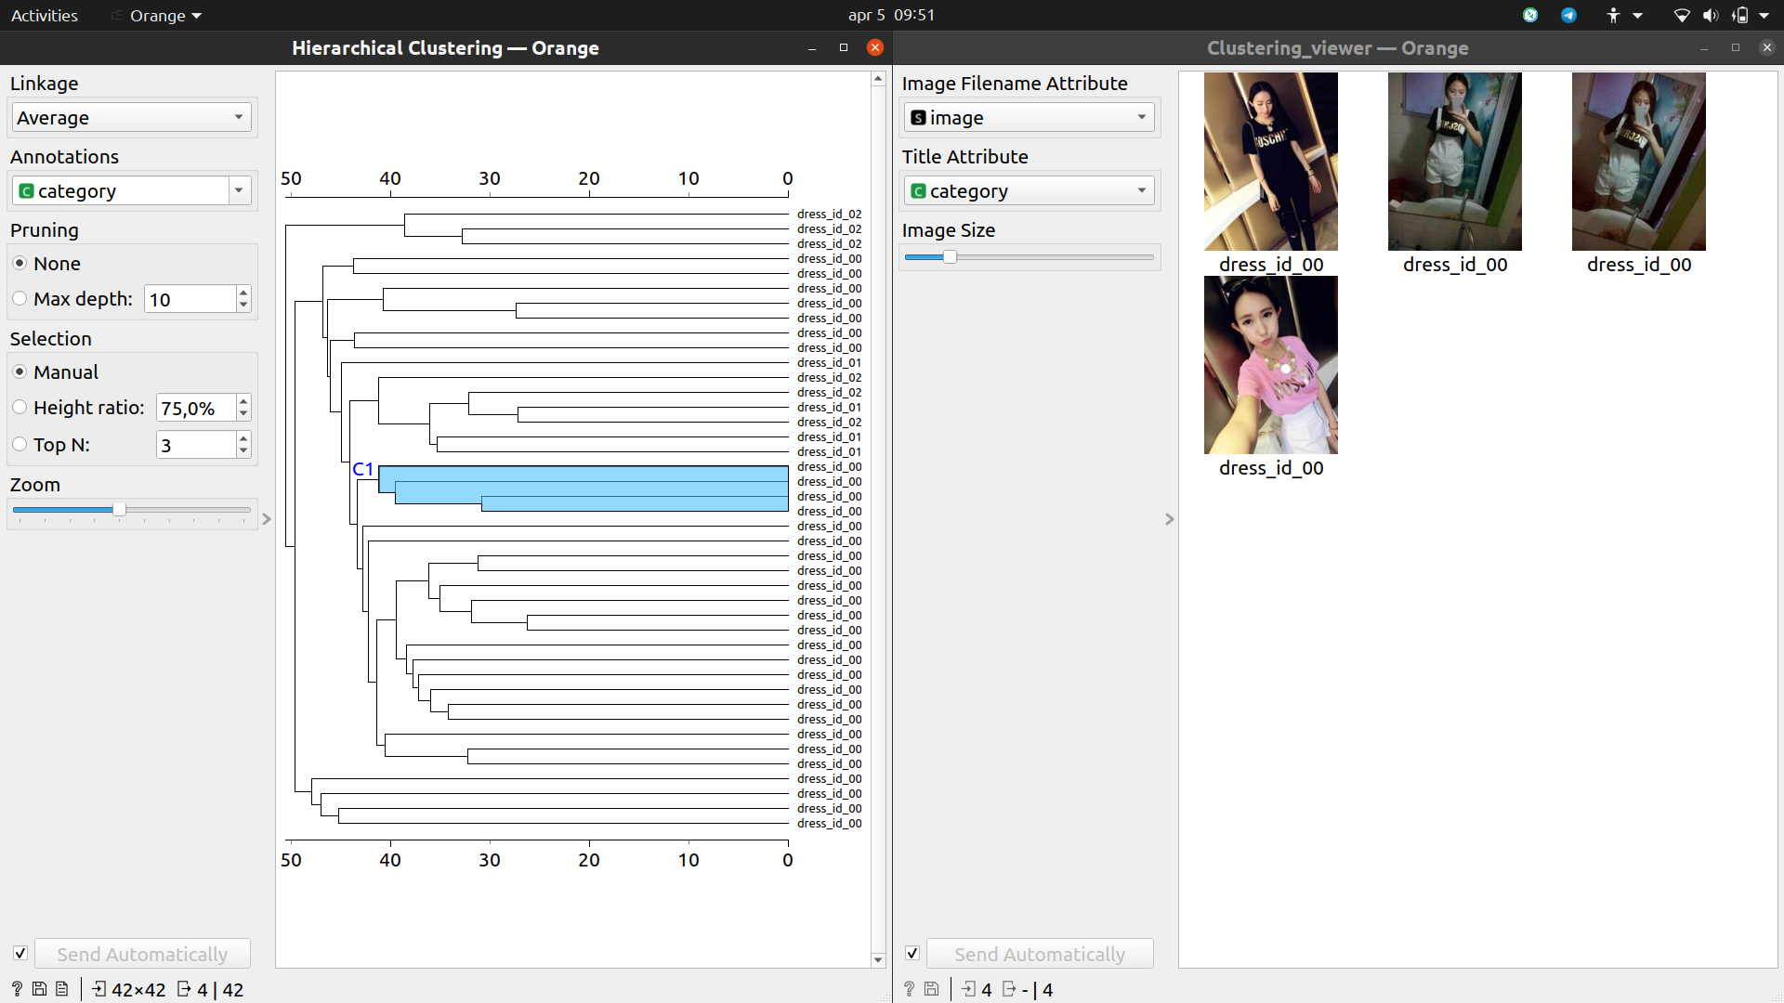

Slide 59
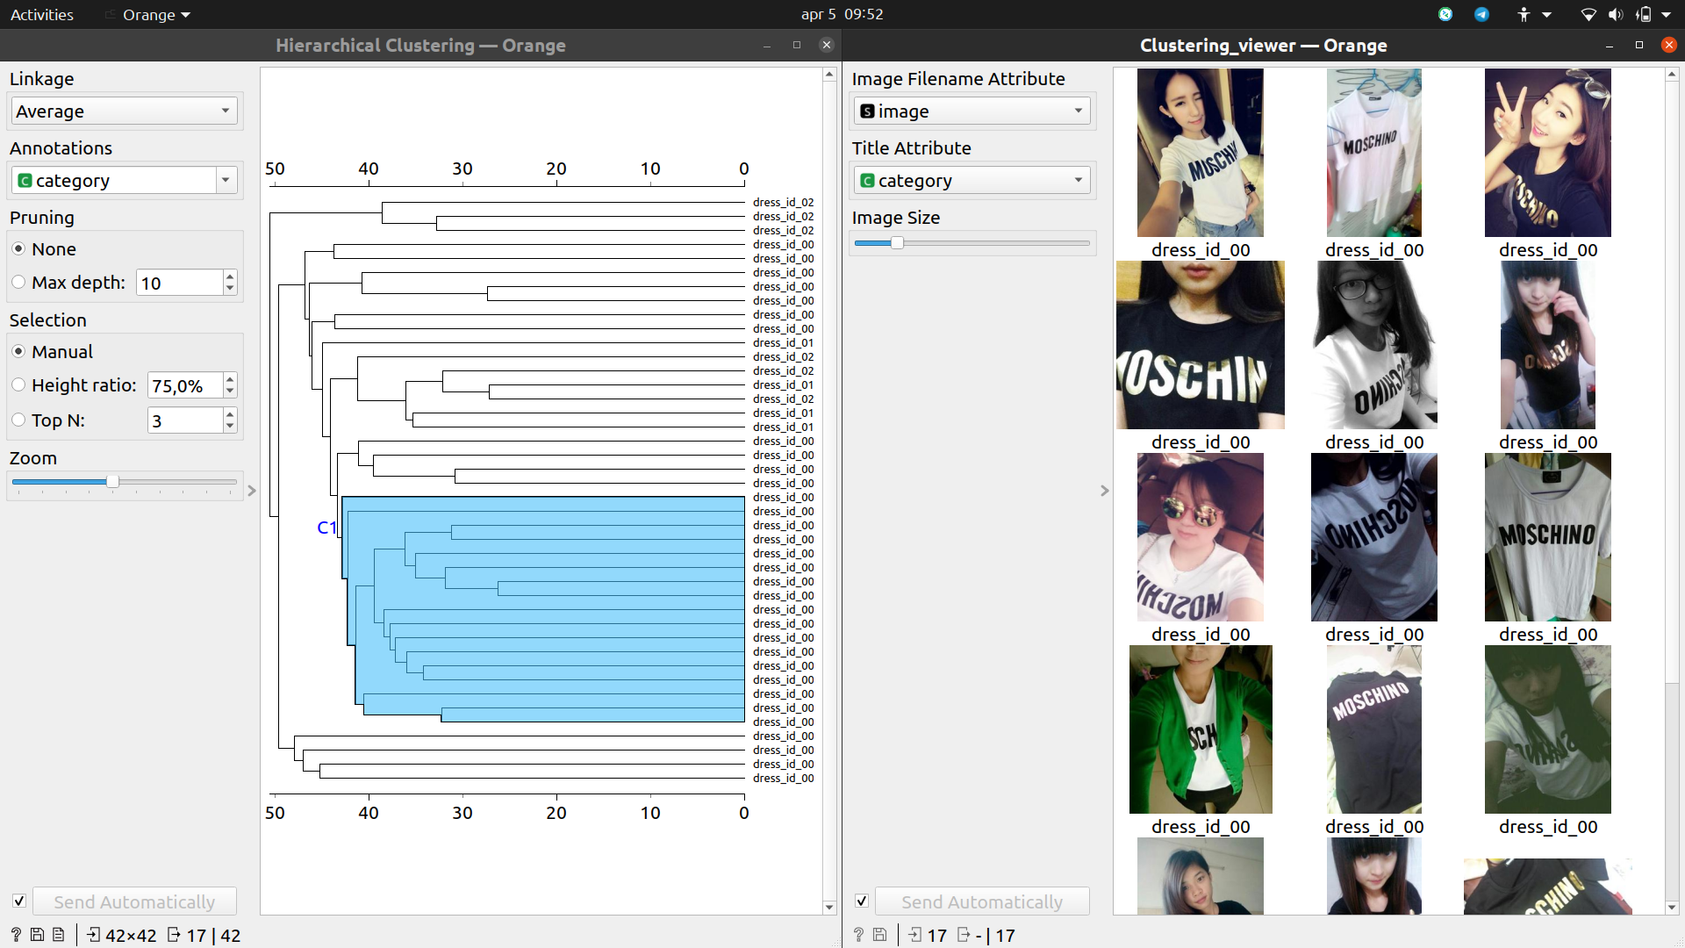

Slide 60
Pasquale Cascarano
Department of the Arts
pasquale.cascarano2@unibo.it

